Slide 1
Spring Web Services
Implementing Loosely Coupled Communication with Spring Web Services

Slide 2
Topics in this Session
Introduction to Web Services
  Why use or build a web service?
  Best practices for implementing a web service
Quick start using Spring Web Services
Endpoint mappings
Object-XML marshalling
Client access

Slide 3
Topics in this Session
Introduction to Web Services
  Why use or build a web service?
  Best practices for implementing a web service
Quick start using Spring Web Services
Endpoint mappings
Object-XML marshalling
Client access
Notes:
The first part of this session can be done very quickly (if you don’t have the time to elaborate a lot) or very extensively. This all depends on your own knowledge of the subject and/or the audience (does the audience know about web services already). Spring Web Services generally goes down quite well, once the audience understands the purpose of it; and sometimes this is quite a challenge to get across! The first couple of slides introduce the audience to the world of web services and how to create robust, maintainable web services that stand the test of time.

Slide 4
Web Services enable Loose Coupling
“Loosely coupled systems are considered useful when either the source or the destination computer systems are subject to frequent changes”
Wikipedia (July 2007)
Loose coupling increases tolerance… changes should not cause incompatibility

Slide 5
Web Services enable Interoperability
XML is the lingua franca in the world of interoperability
XML is understood by all major platforms
  SAX, StAX or DOM in Java
  System.XML or .NET XML Parser in .NET
  REXML or XmlSimple in Ruby
  Perl-XML or XML::Simple in Perl
Notes:
A lingua franca is defined as being a language widely used beyond the population of its native speakers. This holds for XML as well. It’s the language that makes us understand each other. Whether we are programming in .NET, in Java, in Ruby, in Perl, in PHP or any other language.
Stress that we’re not necessarily using SOAP to implement web services (although this will be mentioned later on). XML is what what we’re using, not necessarily SOAP! Web Services does not per se mean we use SOAP.

Slide 6
Best practices for implementing web services
Remember:
  web services != SOAP
  web services != RPC
Design contract independently from service interface
Refrain from using stubs and skeletons
Don’t use validation for incoming requests
Use XPath
http://blog.springframework.com/arjen/archives/2007/03/27/ws-duck-typing/
Postel’s law:
“Be conservative in what you do;
be liberal in what you accept from others.”
Notes:
This slide again, can be somewhat meaty if you want to spend a lot of time on it. It contains a lot in one slide. Refrain from elaborating if you’re not comfortable presenting it in detail. Some explanations:
Web Services != SOAP. A web service is generally implemented using XML, but REST is just as much based on XML as SOAP. Web Services does not generally mean SOAP. Some people are actually ironically saying: the worst possible choice you can make to implement a web service is to use SOAP. Of course you should take this with a grain of salt, but one should certainly not immediately choose SOAP to implement a web service
Designing your contract independently from your service interface ensures you have the possibility to design a contract that is entirely focus on a clean and simple message exchange instead of an easy mapping to your service interface. This also ensures you will much more likely be able to change your service interface (or your contract for that matter) without you requiring to change your contract a lot.
Refrain from using stubs and skeletons. These are usually generated using a build process and sometimes by hand. Stubs and skeletons are usually directly coded against, without providing for a compatibility layer. Here as well, stubs and skeletons tightly couple the two systems instead of loosely coupling them, which is bad
Don’t use validation: there’s this law (Postel’s Law) that says: be liberal in what you accept, be conservative in what you send. Validating the incoming message would immediately mean you don’t adhere to this law anymore--you’re strictly validating incoming messages, which directly means only one format is accepted (think about this: does it really matter if a <user-id> tag is inside a compound <person> tag or not)
Use XPath. Using XPath you can overcome differences in messages (ordering, nesting, et cetera). XPath does not care, whereas parsers based on StAX, SAX or even certain Object-XML mappers are not really flexible about this. Again, does it matter is a first-name tag appears before or after the last-name tag.
Again, try to read up on some of the material Arjen wrote on his blog (especially the WS-DuckTyping entry).

Slide 7
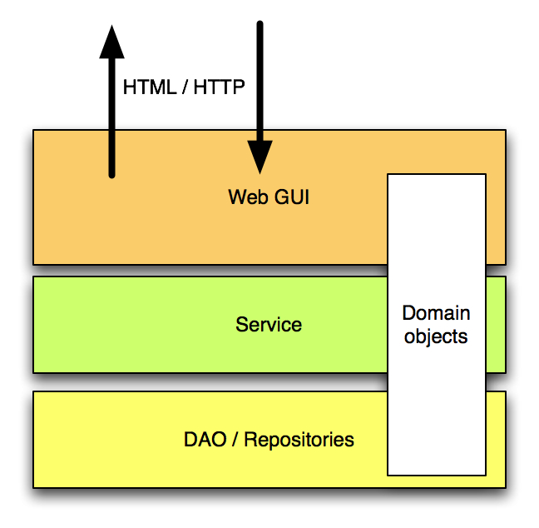
Web GUI on top of your services
The Web GUI layer
provides compatibility between HTML-based world of the user (the browser) and the OO-based world of your service
Notes:
Just as Web GUI layers exist to provide compatibility between the HTML-based world of browsers and to loosely couple of the web user from your service, web services exist to decouple the Java-based world of your service from the XML the users speaks. An interesting question to ask might be the following: “How many time do you spend on the development of the web GUI tier usually?”. The typical answer is somewhere between 60% and 90%. Without drawing conclusions, go to the next slide.

Slide 8
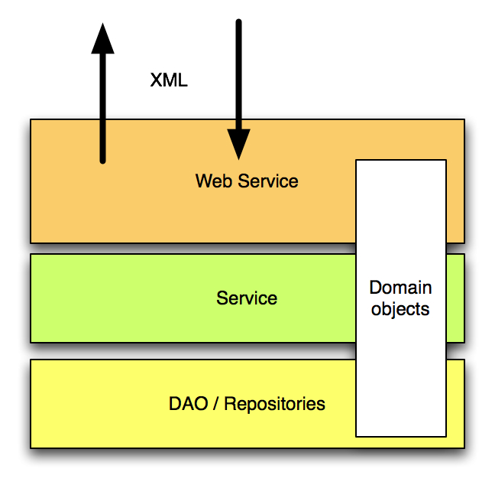
Web Service on top of your services
Web Service layer
provides compatibility between XML-based world of the user and the OO-based world of your service
Notes:
Just mention that we’re going to use the same approach we’ve used for the Web GUI for the web services layer. In the end this will lead to the necessary conclusion that web services are not *just* another remoting protocol and that it’ll require more time to implement a web services than ‘just putting an extra line of XML in service-config.wsdd as with Axis1’.
You can mention here that the web service layer takes care of all compatibility issues such as versioning, incomplete messages, et cetera.

Slide 9
Topics in this Session
Introduction to Web Services
  Why use or build a web service?
  Best practices for implementing a web service
Quick start using Spring Web Services
Endpoint mappings
Object-XML marshalling
Client access

Slide 10
Consistency: MVC and Web Services
Spring Web Services is much like Spring MVC!
Spring Web MVC | Spring Web Services
DispatcherServlet | MessageDispatcher
HandlerMapping | EndpointMapping
Controller | Endpoint
HandlerInterceptor | EndpointInterceptor
Notes:
Shortly explain what each component is responsible for. Keep it to a Spring MVC comparison, you don’t want to go and explain each and every component in Spring-WS here already. Remember: it’s a quickstart!
MessageDispatcher is the front controller accepting incoming web services requests for all web services in a specific application
EndpointMapping decides which web services requests are routed to which web service endpoints
Endpoints handle actual incoming web services requests (messages)
EndpointInterceptor can transparently intercept requests

Slide 11
Define a schema for the web service message
<transfer>
<credit>S123</credit>
<debit>C456</debit>
<amount>1205.15</amount>
</transfer>
<xs:schema
xmlns:xs="http://www.w3.org/2001/XMLSchema"
xmlns:tr="http://mybank.com/schemas/tr"
elementFormDefault="qualified"
targetNamespace="http://mybank.com/schemas/tr">
<xs:element name="transfer">
<xs:complexType>
<xs:sequence>
<xs:element name="credit" type="xs:string"/>
<xs:element name=“debit" type="xs:string"/>
<xs:element name="amount" type="xs:decimal"/>
</xs:sequence>
</xs:complexType>
</xs:element>
</xs:schema>
Notes:
Refer back to the best practices slides, as this is the first thing that you might want to do when looking at a web service for the transfer service.

Slide 12
Bootstrap the application tier
Inside <webapp/> within web.xml
<context-param>
<param-name>contextConfigLocation</param-name>
<param-value>
/WEB-INF/transfer-app-cfg.xml
</param-value>
</context-param>
<listener>
<listener-class>
org.springframework.web.context.ContextLoaderListener
</listener-class>
</listener>
The application context’s configuration file(s)
Loads the ApplicationContext into the ServletContext
before any Servlets are initialized
Notes:
Mention that this might (or actually *will*) be the same context as the one used by the web app.

Slide 13
Wire up the Front Controller
(MessageDispatcher)
Inside <webapp/> within web.xml
<servlet>
<servlet-name>transfer-ws</servlet-name>
<servlet-class>..ws..MessageDispatcherServlet</servlet-class>
<init-param>
<param-name>contextConfigLocation</param-name>
<param-value>/WEB-INF/transfer-ws-cfg.xml</param-value>
</init-param>
</servlet>
The application context’s configuration file(s)
containing the web service infrastructure beans

Slide 14
Map the Front Controller
Inside <webapp/> within web.xml
<servlet-mapping>
<servlet-name>transfer-ws</servlet-name>
<url-pattern>/services/*</url-pattern>
</servlet-mapping>
There might also be a web interface (GUI) that is
mapped to another path

Slide 15
Implement the Endpoint
public class TransferServiceEndpoint implements PayloadEndpoint {
private TransferService transferService;
public TransferServiceEndpoint(TransferService transferService) {
this.transferService = transferService;
}
public Source invoke(Source request) {
// extract necessary info from request and invoke service
}
}
javax.xml.transform.Source
may be DOM, SAX, or Stream

Slide 16
Configure the Endpoint
<bean id=“transferEndpoint”
class=“example.ws.TransferServiceEndpoint”>
<constructor-arg ref=“transferService”/>
</bean>
‘transferService’ is defined in the application tier

Slide 17
Map the Endpoint
<bean class=“org.springframework.ws.server.endpoint.mapping.
PayloadRootQNameEndpointMapping”>
<property name=“mappings”>
<props>
<prop key=“{http://mybank.com/schemas/tr}transfer”>
transferEndpoint
</prop>
</props>
</property>
</bean>
Qualified name of the ‘transfer’ element
Bean name of the endpoint

Slide 18
Architecture of our application exposed using a a web service
Clients
Web Service Interface
JVM
Java EE Servlet Container
Web Service Layer (application context)
Local Java Business Interfaces
Application Layer
(application context)

Slide 19
Topics in this Session
Introduction to Web Services
  Why use or build a web service?
  Best practices for implementing a web service
Quick start using Spring Web Services
Endpoint mappings
Object-XML marshalling
Client access

Slide 20
Endpoint Mappings
Spring Web Services provides several strategies for mapping requests to endpoints
  Message Payload
  SOAPAction Header
  XPath
  Annotations

Slide 21
Mapping by Payload Type
<bean class=“org.springframework.ws.server.endpoint.mapping.
PayloadRootQNameEndpointMapping”>
<property name=“mappings”>
<props>
<prop key=“{http://mybank.com/schemas/tr}transfer”>
transferEndpoint
</prop>
<prop key=“{http://mybank.com/schemas/tr}balanceRequest”>
checkBalanceEndpoint
</prop>
</props>
</property>
</bean>
Two request types, two endpoints

Slide 22
Mapping by SOAPAction HTTP Header
<bean class=“org.springframework.ws.soap.server.endpoint.mapping.
SoapActionEndpointMapping”>
<property name=“mappings”>
<props>
<prop key=“http://mybank.com/TransferRequest”>
transferEndpoint
</prop>
<prop key=“http://mybank.com/BalanceRequest”>
checkBalanceEndpoint
</prop>
</props>
</property>
</bean>
Unique SOAPAction per operation as defined in the WSDL

Slide 23
Mapping by XPath Expression
<bean class=“org.springframework.ws.soap.server.endpoint.mapping.
XPathPayloadEndpointMapping”>
<property name=“namespaces”>
<props>
<prop key=“tr”>http://mybank.com/schemas/tr</prop>
</props>
</property>
<property name=“expression” value=“/tr:request/@type”/>
<property name=“mappings”>
<props>
<prop key=“transfer”>transferEndpoint</prop>
<prop key=“balance”>checkBalanceEndpoint</prop>
</props>
</property>
</bean>
Result of XPath evaluation maps to an endpoint bean name

Slide 24
Mapping by Annotations
@Endpoint
public class MyBankEndpoint {
private AccountService accountService;
public MyBankEndpoint(AccountService accountService) {
this.accountService = accountService;
}
@PayloadRoot(localPart=“balanceRequest”, namespace=“..”)
public Balance checkBalance(BalanceRequest request) { … }
@PayloadRoot(localPart=“transferRequest”, namespace=“..”)
public void transfer(TransferRequest request) { … }
}
<bean class=“org.springframework.ws.server.endpoint.mapping.
PayloadRootAnnotationMethodEndpointMapping”/>

Slide 25
Topics in this Session
Introduction to Web Services
  Why use or build a web service?
  Best practices for implementing a web service
Quick start using Spring Web Services
Endpoint mappings
Object-XML marshalling
Client access

Slide 26
Object-XML Marshalling
Spring Web Services provides an abstraction for translating between Objects and XML
public interface Marshaller {
void marshal(Object graph, Result result)
throws XmlMappingException, IOException;
}
javax.xml.transform.Result
public interface Unmarshaller {
Object unmarshal(Source source)
throws XmlMappingException, IOException;
}
javax.xml.transform.Source
Result and Source may be DOM, SAX, or Stream

Slide 27
Marshaller Implementations
All popular OXM technologies are supported
  JAXB (1 and 2)
  Castor
  JiBX
  XmlBeans
  XStream

Slide 28
XmlMappingException Hierarchy
Exceptions thrown from the underlying marshalling technology are translated into a common hierarchy
XmlMappingException
GenericMarshallingFailureException
ValidationFailureException
MarshallingFailureException
UnmarshallingFailureException

Slide 29
Using Spring OXM Marshallers
Marshaller implementations are in the org.springframework.oxm package
The spring-oxm.jar file can be used on its own
These classes implement both interfaces: Marshaller and Unmarshaller
You can provide the same instance to both marshaller and unmarshaller properties of
  AbstractMarshallingPayloadEndpoint (server side)
  WebServiceTemplate (client side)

Slide 30
Marshalling with JAXB
JAXB can translate the XML schema of your contract into Java classes
JAXB2 can also generate a schema from annotated Java classes
http://java.sun.com/webservices/jaxb/about.html

Slide 31
Configuring a JAXB1 Marshaller
JAXB1 requires the ‘contextPath’
<bean id=“marshaller”
class=“org.springframework.oxm.jaxb.Jaxb1Marshaller”>
<property name=“contextPath”
value=“com.mybank.ws.model”/>
</bean>
<oxm:jaxb1-marshaller contextPath=““com.mybank.ws.model”/>

Slide 32
Configuring a JAXB2 Marshaller
JAXB2 also understands ‘classesToBeBound’
<bean id=“marshaller”
class=“org.springframework.oxm.jaxb.Jaxb2Marshaller”>
<property name=“classesToBeBound”>
<list>
<value>com.mybank.TransferRequest</value>
<value>com.mybank.Receipt</value>
</list>
</property>
<property name=“schema” value=“classpath:com/mybank/tr.xsd”/>
</bean>
Provide schema to enforce validation

Slide 33
Configuring a Castor Marshaller
Castor requires no special configuration but may be fine-tuned with a mapping file
<bean id=“marshaller”
class=“org.springframework.oxm.castor.CastorMarshaller”>
<property name=“mappingLocation”
value=“classpath:castor-mapping.xml”/>
</bean>
http://castor.org/xml-mapping.html

Slide 34
Configuring a JiBX Marshaller
JiBX requires a binding definition document (similar to an ORM mapping file)
Its binding compiler then enhances class files
<bean id=“transferRequestMarshaller”
class=“org.springframework.oxm.jibx.JibxMarshaller”>
<property name=“targetClass”
value=“com.mybank.TransferRequest”/>
</bean>
http://jibx.sourceforge.net

Slide 35
Configuring an XmlBeans Marshaller
XmlBeans generates classes from a schema
The classes extend XmlObject and have binding information (cannot marshal any Object)
<bean id=“marshaller”
class=“org.springframework.oxm.xmlbeans.XmlBeansMarshaller”/>
http://xmlbeans.apache.org

Slide 36
Configuring an XStream Marshaller
XStream serializes Objects to XML (and symmetrically deserializes)
No configuration is required, but aliases may be specified
<bean id=“marshaller”
class=“org.springframework.oxm.xstream.XStreamMarshaller”>
<property name=“aliases”>
<prop key=“Transfer”>com.mybank.TransferRequest</prop>
</property>
</bean>
http://xstream.codehaus.org

Slide 37
Topics in this Session
Introduction to Web Services
  Why use or build a web service?
  Best practices for implementing a web service
Quick start using Spring Web Services
Endpoint mappings
Object-XML marshalling
Client access

Slide 38
Spring Web Services on the Client
WebServiceTemplate
  Simplifies web service access
  Works directly with the XML payload
    Extracts body of a SOAP message
    Also works with POX (Plain Old XML)
  Can use marshallers/unmarshallers
  Provides convenience methods for sending and receiving web service messages
  Provides callbacks for more sophisticated usage

Slide 39
Hello World with WebServiceTemplate
WebServiceTemplate template = new WebServiceTemplate();
String uri = “http://myserver/EchoService”;
Source source = new StreamSource(new StringReader(
“<hello-world/>”));
Result result = new StreamResult(System.out);
template.sendSourceAndReceiveToResult(uri, source, result);

Slide 40
Marshalling with WebServiceTemplate
<bean id=“webServiceTemplate”
class=“org.springframework.ws.client.core.WebServiceTemplate”>
<property name=“defaultUri” value=“http://mybank.com/transfer”/>
<property name=“marshaller” ref=“marshaller”/>
<property name=“unmarshaller” ref=“marshaller”/>
</bean>
<bean id=“marshaller” class=“org.springframework.oxm.castor.CastorMarshaller”>
<property name=“mappingLocation” value=“classpath:castor-mapping.xml”/>
</bean>
WebServiceTemplate template =
(WebServiceTemplate) context.getBean(“webServiceTemplate”);
TransferRequest request = new TransferRequest(“S123”, “C456”, “85.00”);
Receipt receipt = (Receipt) template.marshalSendAndReceive(request);

Slide 41
WebServiceMessageCallback
WebServiceTemplate template =
(WebServiceTemplate) context.getBean(“webServiceTemplate”);
BalanceRequest request = new BalanceRequest(“S123”);
Balance result = (Balance) template.marshalSendAndReceive(request,
new WebServiceMessageCallback() {
public void doWithMessage(WebServiceMessage message) {
((SoapMessage)message).setSoapAction(
“http://mybank.com/BalanceRequest”);
}
});
Modifies the message after it is created but before it is sent

Slide 42
WebServiceMessageExtractor
WebServiceTemplate template =
(WebServiceTemplate) context.getBean(“webServiceTemplate”);
BalanceRequest request = new BalanceRequest(“S123”);
Balance result = (Balance) template.sendAndReceive(
new WebServiceMessageCallback() { /* prepare request */ },
new WebServiceMessageExtractor() {
public Object extractData(WebServiceMessage message) {
Result result = message.getPayloadResult();
// transform and return your result
}
});

Slide 43
LAB
Exposing SOAP Endpoints using
Spring Web Services

